Slide 1
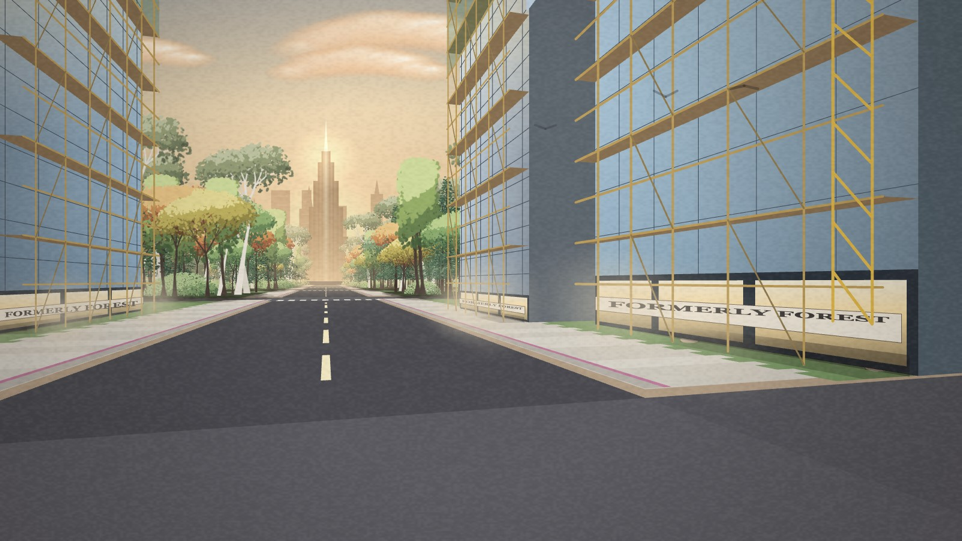
A2C REFLECTION · 1 OF 2
Hand gestures as interaction
RECOUNT
REACT
ml5 hand tracking: each hand acts on its own side of the street.
The keyboard uses the same clearing and building functions.
Gestures feel direct, not like throwing dice in my Monopoly version.
A dependable keyboard beats an unreliable gesture.
Swing clears land.
Lift raises buildings, floor by floor.
Hand shape picks homes, shops or industry; height picks the size.
ANALYSE
IMPROVE
One swing across the middle was read as two half-swings.
Matching the concept does not guarantee usability.
Test with three users at the first prototype, no coaching.
Record missed gestures, accidents and requests for help.
Meaningful and dependable are two separate jobs.
Notes:
Opening (15 s):
We Build Our World is a first-person street that begins as a painted forest. You clear trees and build, with camera gestures or the keyboard. It started as a Monopoly-inspired street; now it asks what building replaces. My reflection has two parts.
Recount:
The first is hand gestures. I use ml5 hand tracking: each hand acts on its own side of the street. A quick sideways stroke clears land, lifting grows buildings floor by floor, and hand height picks the size. The keyboard uses the same functions.
React:
I wanted walking through this world to feel direct, not depend on throwing dice like my Monopoly version. I prefer the gestures, because swinging and lifting make clearing and building feel physically different. But the camera adds uncertainty, and I would rather show a dependable keyboard than let an unreliable gesture hide the concept. Sophistication only helps when it supports the experience.
Analyse:
A swing suggests cutting and lifting looks like growth, but I have not yet proven that new users read it that way. Early on, one hand swinging across the middle was read as two half-swings, so nothing was cleared. So matching the concept does not guarantee usability. Making an action meaningful and making it dependable are two separate jobs.
Improve:
Next time I will test with three users at the first working prototype, without coaching, and record missed gestures, accidental actions and requests for help.

Slide 2
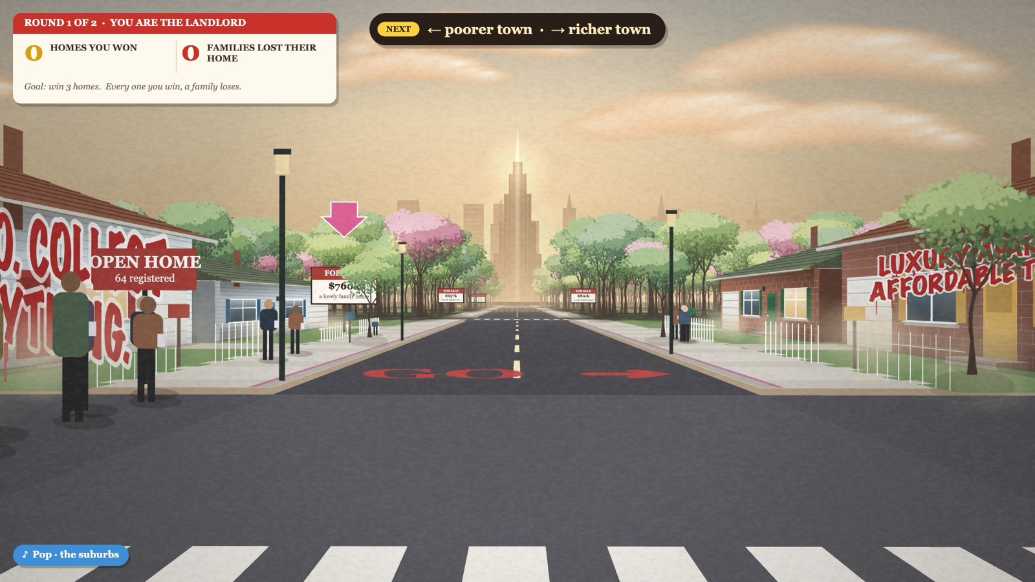
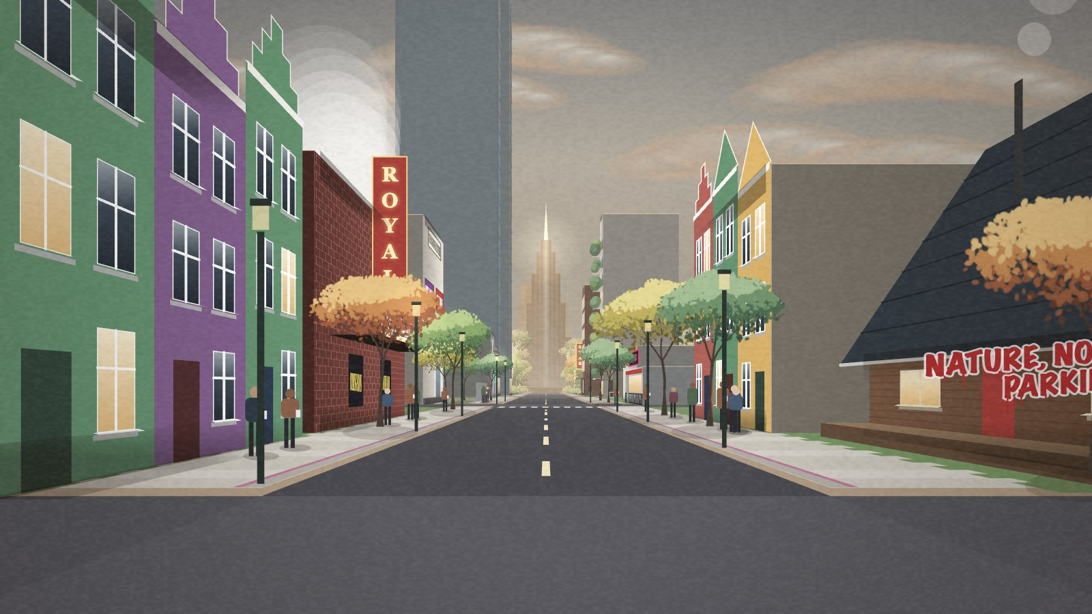
A2C REFLECTION · 2 OF 2
Reducing the concept
RECOUNT
REACT
Monopoly street, buying and rent narrowed to forest, clearing, building and looking back.
Every building needs forest cleared.
Frustrated I could not explain my own project.
I had linked visual richness with a better result.
BEFORE: BUYING, RENT, SIGNS
ANALYSE
IMPROVE
I added features before defining how they relate.
Taking things away gave what was left one purpose.
One central question before expanding.
Test a one-minute version with a newcomer.
NOW: FOREST, BUILD, LOOK BACK
Notes:
Recount:
My earlier direction combined a Monopoly street with buying, rent and a lot of information. It narrowed to forest, clearing, building and looking back. Every new building now needs forest cleared, the sound follows nearby development, and the haze grows with the buildings, factories counting more.
React:
I was frustrated when I could not explain what my own project was doing. I had linked visual richness with a better result. I now prefer the clearer direction, even though I gave up worlds I liked. I want building to feel inviting, but also consequential.
Analyse:
My real problem was adding features before defining how they relate. Extra mechanics needed more instructions, so the explanation competed with the landscape. Taking things away gave what was left one shared purpose. But consistent sound and visuals can support a meaning without proving people understand it.
Improve:
I will define one central question before expanding a prototype, keep the last quarter of the schedule for evaluation, and test a one-minute version with a newcomer before another big pivot.

Slide 3
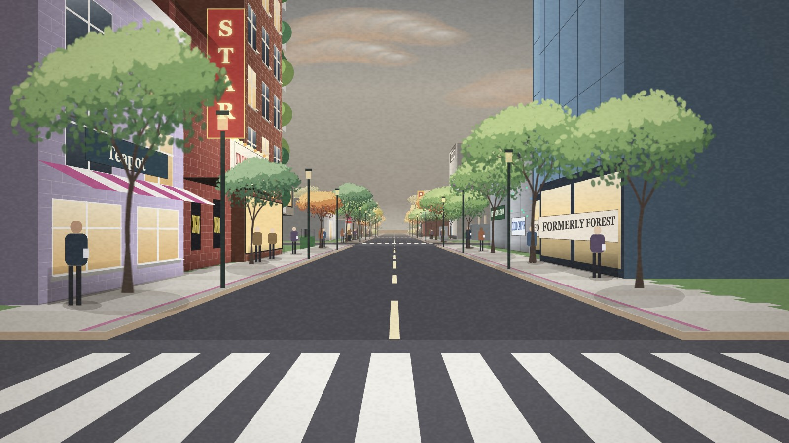
WHAT I LEARNED
An idea must be simple enough for the interaction to carry it.
Testing, not extra features, makes it dependable.
It largely achieved its aim: participants cause a transformation and can look back on it, though strangers may not yet read it as intended.
Notes:
It largely achieved its aim: participants cause a transformation and can look back on it, though strangers may not yet read it as intended. I learned that an idea must be simple enough for the interaction to carry it, and that testing, not extra features, makes it dependable.

